Slide 1




Mobile Sales
Presented By M Priyadarshini

Slide 2

Aim of the Project
This project aimed to analyze how discounts affect mobile phone sales and ratings, using EDA and statistical tests to optimize discount strategies.

Slide 3
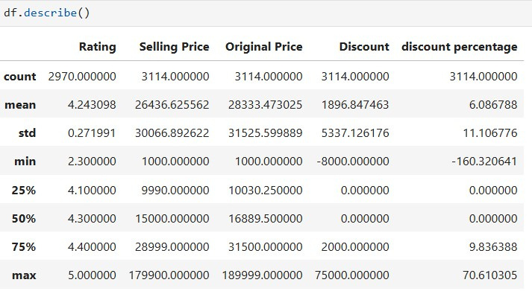
Data Structure
01
Rows & Columns: 3114 & 12
02
Data Types: object, float
03
Summary Statistics:

Slide 4
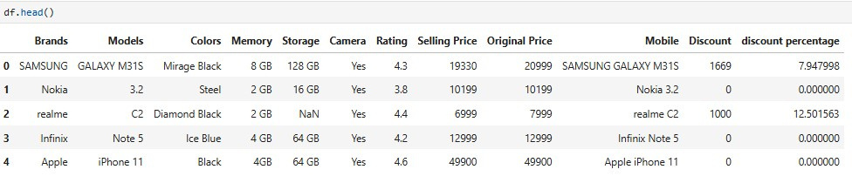
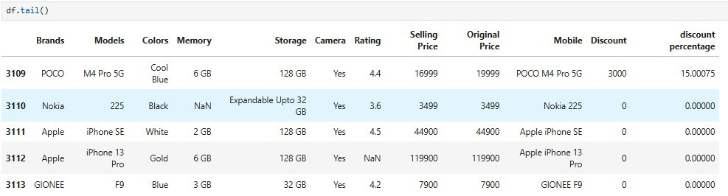
Dataset Analysis

Slide 5
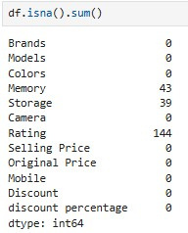
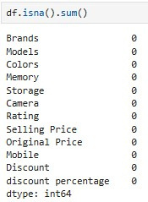

Before & After Comparison of Null Values
Handle Null Values

Slide 6



Handle Duplicate Values
Before & After Comparison of Duplicate Values
Column Rename

Slide 7
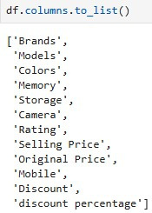
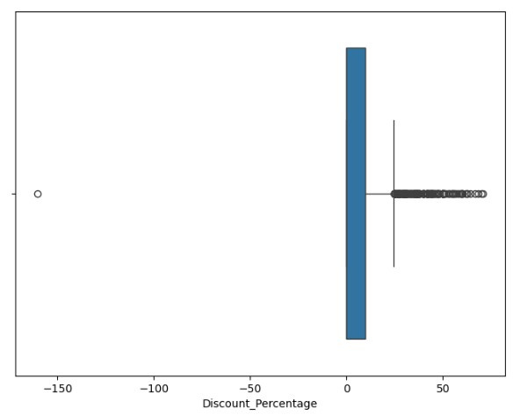

Column Reduce
Outlier

Slide 8
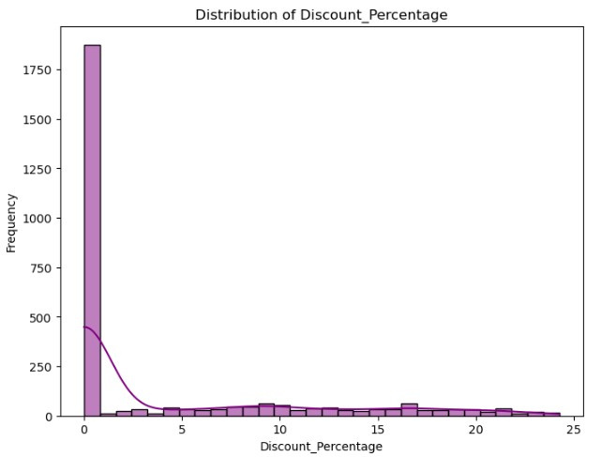
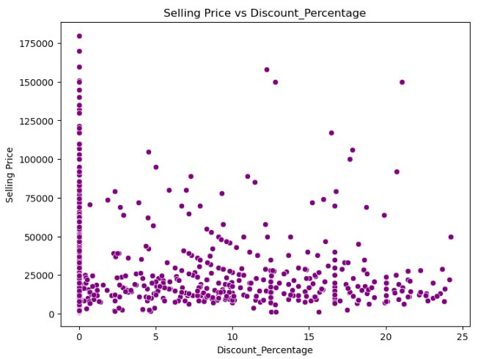
Histogram
Scatter Plot

Slide 9
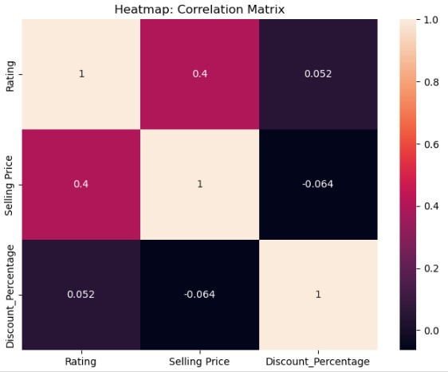
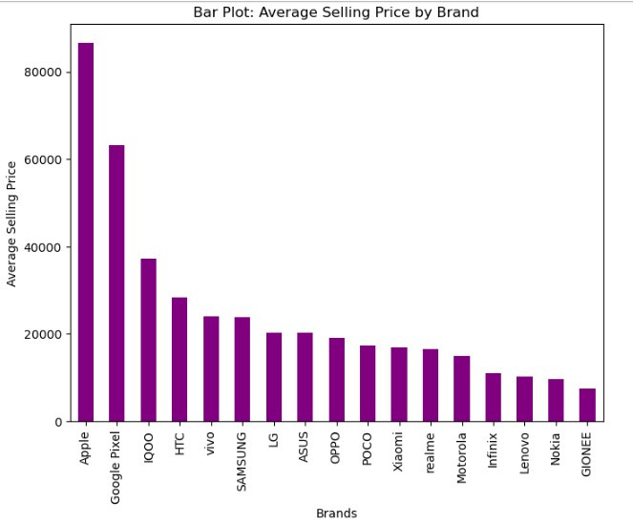
Heatmap
Bar Plot

Slide 10
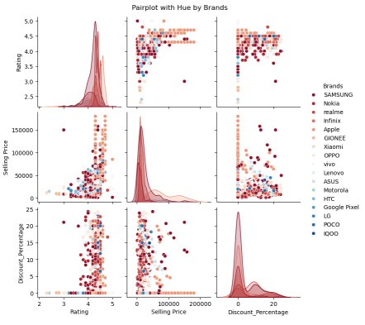
Pair Plot

Slide 11

Hypothesis Test
A hypothesis test in statistics is a method used to determine whether there is enough evidence to reject a null hypothesis, based on sample data. It helps assess whether a certain assumption or claim about a population is true.
Types:
Null Hypothesis (H₀)
Alternative Hypothesis (H₁)

Slide 12

Two-Sample Independent t-Test
01
The two-sample t-test was used to compare the ratings of mobile phones between two groups: phones with high discounts and phones with low discounts.
02
The objective was to check if the average ratings of the two groups differ significantly.
03
If the p-value is low, we conclude that discounts influence ratings differently in the two groups.

Slide 13
One-Sample t-Test
01
The one-sample t-test was used to compare the average discount percentage with a hypothesized value (e.g., 20%)
02
The goal was to determine if the actual average discount is significantly different from this hypothesized value.
03
If the p-value is low (less than 0.05), we reject the null hypothesis .

Slide 14
Conclusion
This project shows that discounts affect sales and ratings. It provides insights to help businesses improve pricing and stay competitive in the mobile phone market.

Slide 15

Thank You

